Slide 1

Presented By: Parth Desai: IU1841230011 Yash Kakrecha: IU1841230022 Manav Prajapati: IU1841230045 | Final Year IDP Project at INEXTURE Solutions LLP, A 'bad
Guided By: Dr. Nimisha Patel

Slide 2
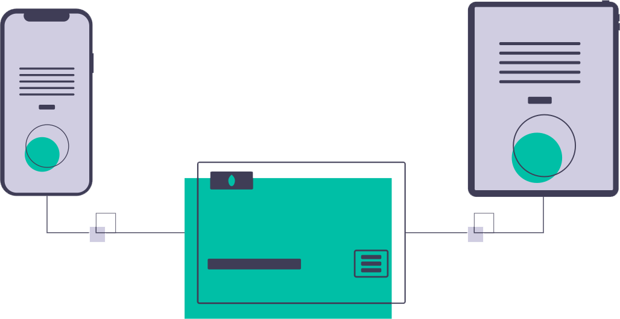
ABOUT
Expense Tracker is a web application for splitting expenses with your friends. It lets you and your friends add various bills and keep track of who owes who, and then it helps you to settle up with each other.
<number>

Slide 3
OUR PROCESS
1
<number>

Slide 4
OUR PROCESS
Exploring Analyzing the problem
Designing
User Interface
Testing
1
3
5
2
4
6
Determining the Functionalities & Requirements
Development
Deployment
<number>

Slide 5
PROBLEMS
2
<number>

Slide 6

PROBLEMS
Splitting bills on lunch or dinner.
Complex calculation for splitting the bill evenly.
Tough to keep track of debts.
Consumes time for expense calculation.
<number>

Slide 7
OBJECTIVES
3
<number>

Slide 8

OBJECTIVES
Maintains the record of your expenses.
Up to date track record of all debts.
Transparent and error free split process.
Time saving from complex calculations.
<number>

Slide 9
FIRST VIEW
7
<number>

Slide 10
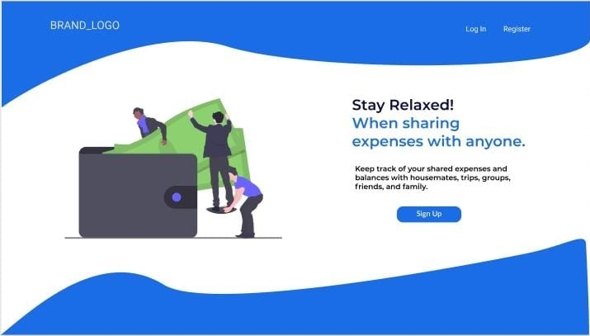
Desktop View
of
<number>

Slide 11
Flowchart
9
<number>

Slide 12
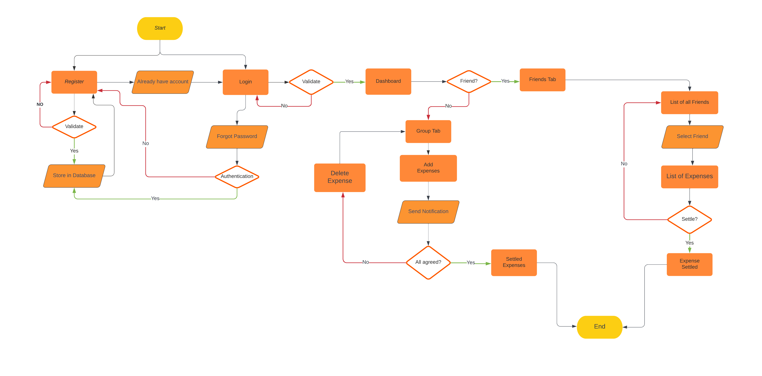
Flowchart
<number>

Slide 13
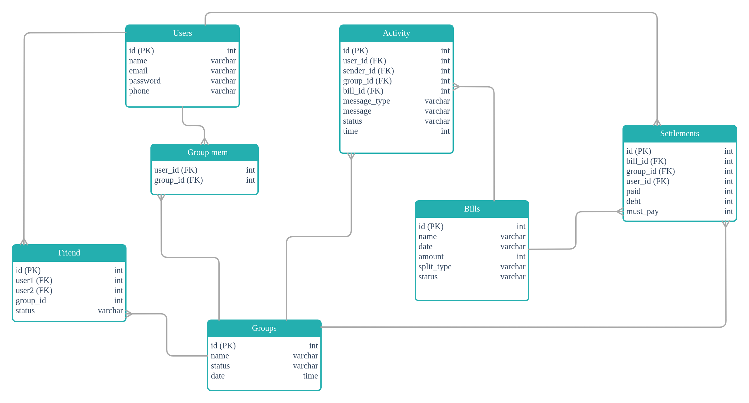
Data Model
<number>

Slide 14
Results
10
<number>

Slide 15
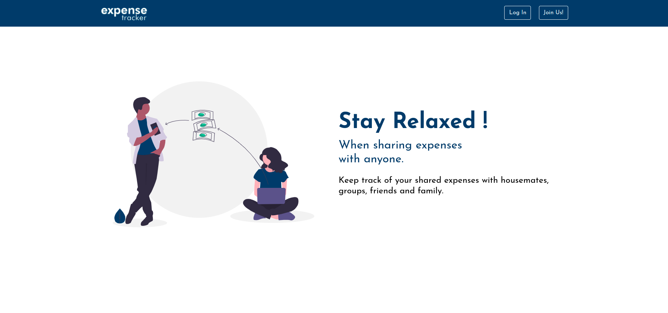
Main Page

Slide 16
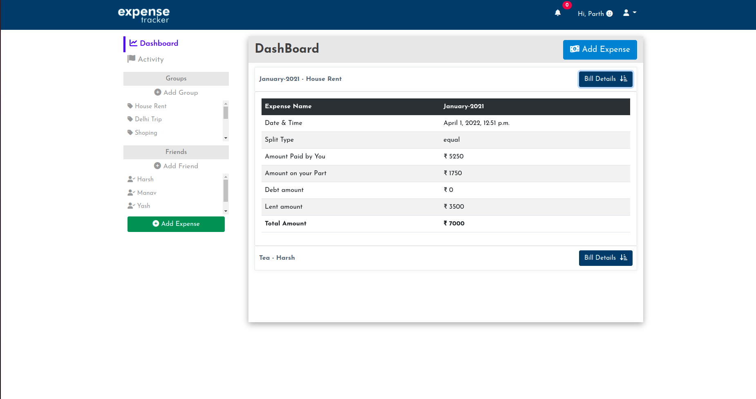
DashBoard

Slide 17
THANK YOU!
<number>

